Slide 1
Stack, Queue in C++ STL Md. Alamgir Hossain Senior Lecturer, Dept. of CSE, Prime University Mail: alamgir.cse14.just@gmail.com

Slide 2
Stack
Stacks are a type of container adaptors with LIFO(Last In First Out) type of working, where a new element is added at one end and (top) an element is removed from that end only.

Slide 3
Some Common Functions Associated with Stack
empty() – Returns whether the stack is empty – Time Complexity : O(1)
size() – Returns the size of the stack – Time Complexity : O(1)
top() – Returns a reference to the top most element of the stack – Time Complexity : O(1)
push(g) – Adds the element ‘g’ at the top of the stack – Time Complexity : O(1)
pop() – Deletes the top most element of the stack – Time Complexity : O(1)

Slide 4
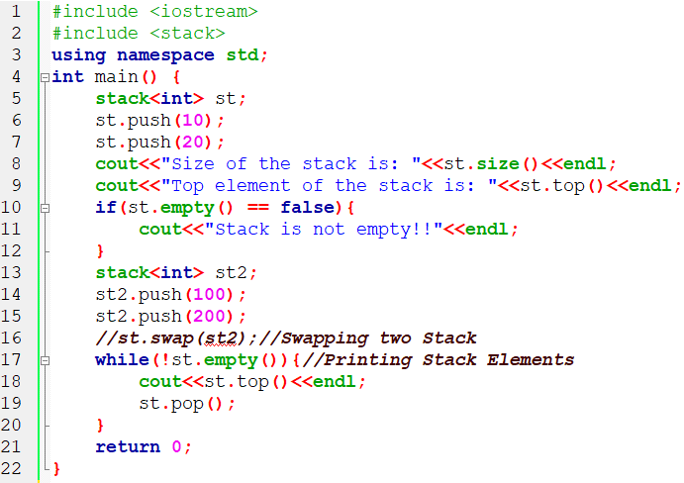
Using some Stack Functions in C++

Slide 5
Queue
Queues are a type of container adaptors that operate in a first in first out (FIFO) type of arrangement.
Elements are inserted at the back (end) and are deleted from the front.

Slide 6
Some Function of Queue in C++ STL
empty() – Returns whether the queue is empty.
size() – Returns the size of the queue.
queue::swap() in C++ STL: Exchange the contents of two queues but the queues must be of the same type, although sizes may differ.
queue::emplace() in C++ STL: Insert a new element into the queue container, the new element is added to the end of the queue.
queue::front() and queue::back() in C++ STL– front() function returns a reference to the first element of the queue.
back() function returns a reference to the last element of the queue.
push(g) and pop() – push() function adds the element ‘g’ at the end of the queue.
pop() function deletes the first element of the queue.

Slide 7
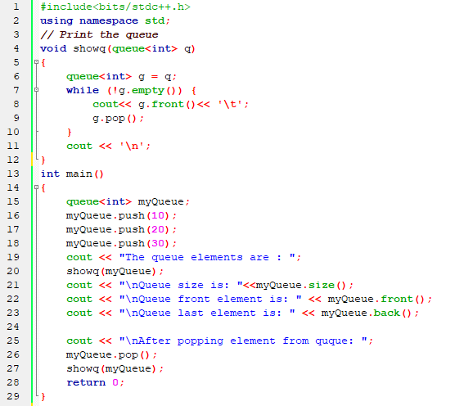
Some Function of Queue in STL C++

Slide 8
Thank You

